Slide 1
ASPIRE FUNDING PLATFORM
House Book
Deals funded 11/01/2024 through 06/30/2026
$30,540,626
994
17.0%
-4.2%
FUNDED
DEALS
PRINCIPAL LOST RATE
RETURN, EXCL. OPEN DEALS
Principal lost rate = principal lost on defaulted deals ÷ total funded. Collections to date are netted in.

Slide 2
The decided book
EXCLUDES 234 OPEN DEALS
$19,467,626
$18,651,252
-$816,374
26.6%
FUNDED
COLLECTED
NET CASH
PRINCIPAL LOST RATE
760 deals
66.5% of contracted payback
-4.2% return on funded capital
$5,184,923 lost
Where the decided book splits
Segment | Deals | Funded $ | Share of decided $ | Net cash | Return | Collected, % of payback
Paid off | 387 | $10,228,126 | 52.5% | $4,384,377 | 42.9% | 100.0%
Defaulted Status | 317 | $7,849,500 | 40.3% | -$4,817,047 | -61.4% | 26.6%

Slide 3
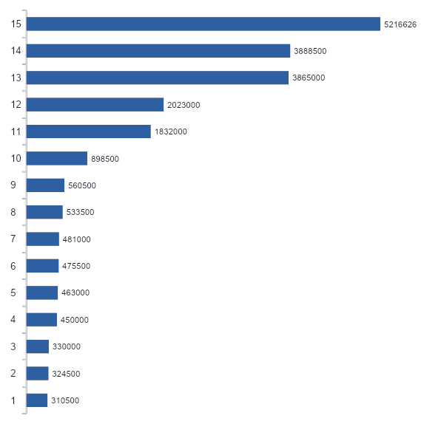
ISO
# | ISO | Deals | Funded $ | Lost rate | Return* (deals) | Net $
1 | Fundwell | 110 | $5,216,626 | 11.5% | 1.3% (81) | $44,492
2 | PMF | 62 | $3,888,500 | 20.3% | -22.5% (42) | -$474,039
3 | United Secured Capital 8 | 162 | $3,865,000 | 24.2% | -11.4% (131) | -$320,652
4 | Westwood | 58 | $2,023,000 | 1.8% | 37.0% (36) | $366,030
5 | Ballicci | 67 | $1,832,000 | 22.3% | -13.8% (45) | -$164,331
6 | Premium Capital (AMRK) | 25 | $898,500 | 4.2% | 27.8% (22) | $123,490
7 | TRUSTFI | 14 | $560,500 | 12.6% | -28.3% (9) | -$51,830
8 | National Business Capital | 13 | $533,500 | 7.1% | 9.0% (8) | $16,016
9 | Shore Funding USA | 25 | $481,000 | 20.0% | -2.9% (20) | -$11,102
10 | Llama Loan | 14 | $475,500 | 2.6% | 12.9% (10) | $20,489
11 | Platform Funding | 21 | $463,000 | 19.9% | -5.0% (16) | -$16,662
12 | Fidelity Funding | 14 | $450,000 | 15.3% | 6.8% (12) | $25,673
13 | Credibly | 10 | $330,000 | 8.7% | -45.6% (2) | -$22,806
14 | Vanguard Equities | 20 | $324,500 | 7.3% | 17.7% (15) | $30,949
15 | Fundible | 19 | $310,500 | 28.7% | -19.3% (16) | -$43,844

Slide 4
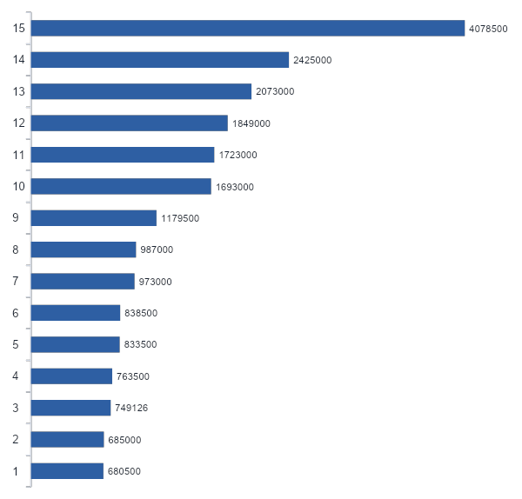
Industry
# | Industry | Deals | Funded $ | Lost rate | Return* (deals) | Net $
1 | Eating & Drinking Places | 140 | $4,078,500 | 14.2% | 2.2% (102) | $58,406
2 | General Building Contractors | 115 | $2,425,000 | 29.7% | -22.9% (92) | -$406,926
3 | Health Services | 54 | $2,073,000 | 21.1% | -18.6% (43) | -$219,569
4 | Special Trade Contractors | 53 | $1,849,000 | 27.7% | -28.2% (38) | -$354,183
5 | Trucking & Warehousing | 71 | $1,723,000 | 15.6% | -0.1% (56) | -$1,405
6 | Miscellaneous Retail | 77 | $1,693,000 | 12.7% | 1.4% (53) | $13,200
7 | Auto Repair & Services | 51 | $1,179,500 | 14.8% | 5.8% (42) | $44,124
8 | Business Services | 42 | $987,000 | 15.2% | -1.6% (32) | -$11,870
9 | Engineering, Accounting & Management | 29 | $973,000 | 10.6% | 8.9% (25) | $60,463
10 | Legal Services | 12 | $838,500 | 3.3% | 37.8% (6) | $168,065
11 | Wholesale Trade - Nondurable Goods | 11 | $833,500 | 32.2% | -16.1% (8) | -$108,553
12 | Real Estate | 18 | $763,500 | 35.5% | -26.8% (13) | -$167,147
13 | Personal Services | 40 | $749,126 | 6.6% | 27.7% (32) | $139,113
14 | Auto Dealers & Gas Stations | 13 | $685,000 | 31.7% | -45.7% (10) | -$173,472
15 | Wholesale Trade - Durable Goods | 15 | $680,500 | 7.4% | 13.0% (14) | $62,498

Slide 5
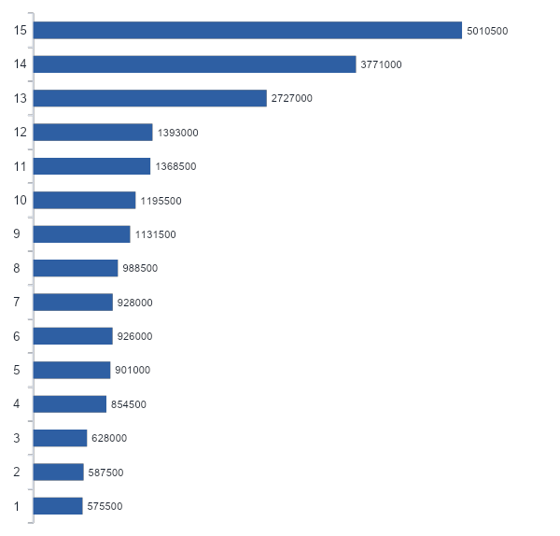
State
# | State | Deals | Funded $ | Lost rate | Return* (deals) | Net $
1 | TX | 183 | $5,010,500 | 13.8% | 5.5% (136) | $179,437
2 | CA | 111 | $3,771,000 | 13.1% | -2.8% (88) | -$58,066
3 | FL | 108 | $2,727,000 | 19.6% | -11.7% (81) | -$232,875
4 | NJ | 31 | $1,393,000 | 14.0% | -9.2% (22) | -$64,331
5 | GA | 48 | $1,368,500 | 15.1% | -4.9% (31) | -$37,198
6 | VA | 32 | $1,195,500 | 23.9% | -7.2% (23) | -$60,216
7 | IL | 26 | $1,131,500 | 8.6% | 26.5% (24) | $243,396
8 | AZ | 24 | $988,500 | 12.5% | -12.6% (18) | -$47,538
9 | PA | 29 | $928,000 | 15.5% | -13.4% (22) | -$53,277
10 | NC | 29 | $926,000 | 41.2% | -44.1% (22) | -$293,874
11 | TN | 28 | $901,000 | 15.1% | -4.3% (19) | -$26,691
12 | MA | 15 | $854,500 | 29.5% | -45.7% (13) | -$223,768
13 | MO | 23 | $628,000 | 6.2% | 24.0% (15) | $82,364
14 | OK | 20 | $587,500 | 15.0% | 14.3% (19) | $77,995
15 | CO | 18 | $575,500 | 27.6% | -14.5% (16) | -$77,016

Slide 6
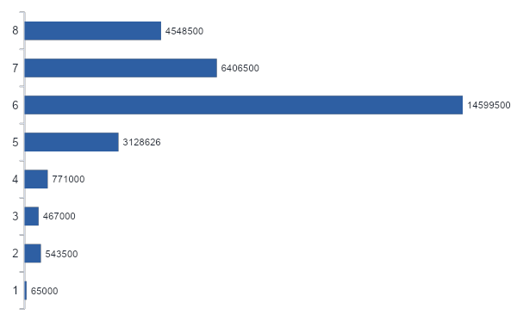
Position
# | Position | Deals | Funded $ | Lost rate | Return* (deals) | Net $
1 | 1 | 147 | $4,548,500 | 12.9% | 6.2% (129) | $198,506
2 | 2 | 203 | $6,406,500 | 18.6% | -5.7% (166) | -$239,599
3 | 3 | 466 | $14,599,500 | 18.8% | -13.2% (306) | -$1,127,784
4 | 4 | 93 | $3,128,626 | 15.3% | 3.6% (80) | $76,692
5 | 5 | 33 | $771,000 | 9.1% | 22.3% (30) | $139,482
6 | 6 | 28 | $467,000 | 15.2% | 13.0% (26) | $52,647
7 | 7 | 20 | $543,500 | 2.9% | 35.6% (19) | $95,538
8 | 8 | 3 | $65,000 | 27.2% | -1.3% (3) | -$855

Slide 7
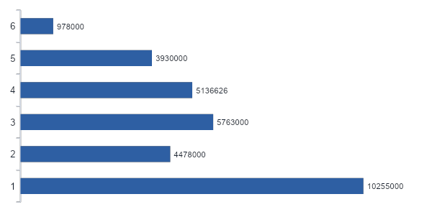
Deal size
# | Deal size | Deals | Funded $ | Lost rate | Return* (deals) | Net $
1 | Under $10K | 168 | $978,000 | 23.7% | -0.9% (152) | -$7,571
2 | $10-20K | 299 | $3,930,000 | 22.3% | -3.5% (242) | -$110,292
3 | $20-30K | 231 | $5,136,626 | 19.4% | -0.8% (178) | -$33,280
4 | $30-50K | 165 | $5,763,000 | 20.3% | -8.2% (115) | -$327,872
5 | $50-100K | 70 | $4,478,000 | 16.5% | -8.3% (42) | -$224,679
6 | $100K+ | 61 | $10,255,000 | 11.5% | -2.3% (31) | -$112,679

Slide 8
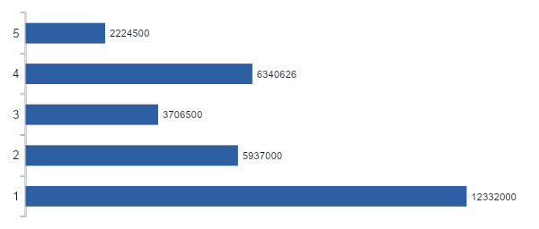
Term (business days)
# | Term (business days) | Deals | Funded $ | Lost rate | Return* (deals) | Net $
1 | Under 60 | 217 | $2,224,500 | 25.7% | -1.7% (206) | -$35,759
2 | 60-89 | 306 | $6,340,626 | 21.6% | -3.4% (245) | -$166,296
3 | 90-119 | 150 | $3,706,500 | 16.0% | 4.6% (112) | $119,977
4 | 120-149 | 170 | $5,937,000 | 23.1% | -18.2% (114) | -$716,856
5 | 150+ | 151 | $12,332,000 | 10.4% | -0.3% (83) | -$17,440

Slide 9
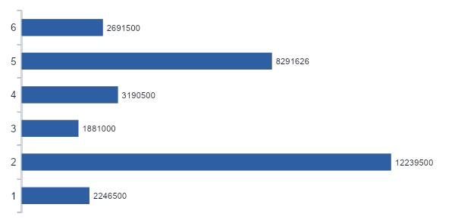
Factor
# | Factor | Deals | Funded $ | Lost rate | Return* (deals) | Net $
1 | 1.35 and under | 51 | $2,691,500 | 5.0% | 10.7% (31) | $168,277
2 | 1.36-1.42 | 165 | $8,291,626 | 16.4% | -6.3% (122) | -$332,976
3 | 1.43-1.45 | 81 | $3,190,500 | 11.3% | -5.7% (48) | -$78,463
4 | 1.46-1.48 | 42 | $1,881,000 | 1.6% | 37.2% (31) | $408,370
5 | 1.49 | 510 | $12,239,500 | 20.9% | -9.1% (385) | -$721,965
6 | Above 1.49 | 145 | $2,246,500 | 33.4% | -11.7% (143) | -$259,617

Slide 10
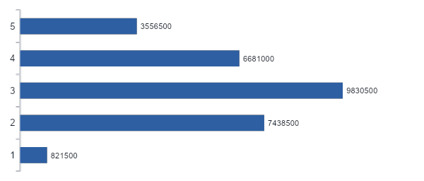
Advance to revenue
152 Deals have no revenue data(79 closed, 69 Defaulted, 4 Open)
# | Advance to revenue | Deals | Funded $ | Lost rate | Return* (deals) | Net $
1 | Under 0.15x | 125 | $3,556,500 | 26.0% | -15.3% (98) | -$399,891
2 | 0.15-0.30x | 253 | $6,681,000 | 15.7% | -3.7% (188) | -$146,967
3 | 0.30-0.50x | 257 | $9,830,500 | 16.3% | -6.5% (185) | -$400,212
4 | 0.50-1.00x | 182 | $7,438,500 | 15.0% | -1.8% (126) | -$74,381
5 | 1.00x+ | 25 | $821,500 | 13.7% | -13.2% (15) | -$49,683

Slide 11
New vs renewal
All categories
New Deal
Renewal
18.4%
12.1%
PRINCIPAL LOST RATE
PRINCIPAL LOST RATE
$23,765,626 funded
$6,775,000 funded
806 deals
188 deals
-7.4% return, excl. open (634 deals)
-$1,162,866 net cash, excl. open
9.2% return, excl. open (126 deals)
$346,492 net cash, excl. open
77.8% of book dollars
22.2% of book dollars

Slide 12
Payment frequency
All categories
Daily
Weekly
20.3%
15.3%
PRINCIPAL LOST RATE
PRINCIPAL LOST RATE
$10,046,126 funded
$20,494,500 funded
534 deals
460 deals
-1.1% return, excl. open (451 deals)
-$82,393 net cash, excl. open
-6.2% return, excl. open (309 deals)
-$733,981 net cash, excl. open
32.9% of book dollars
67.1% of book dollars

Slide 13
Funding year
All years · 2026 is through 06/30 only
2024
2025
2026
46.4%
16.9%
17.0%
PRINCIPAL LOST RATE
PRINCIPAL LOST RATE
PRINCIPAL LOST RATE
$61,000 funded
$11,170,126 funded
$19,309,500 funded
6 deals
491 deals
497 deals
-37.2% return, excl. open (6 deals)
-$22,711 net cash, excl. open
6.6% return, excl. open (472 deals)
$659,691 net cash, excl. open
-15.3% return, excl. open (282 deals)
-$1,453,354 net cash, excl. open
0.2% of book dollars
36.6% of book dollars
63.2% of book dollars

